Slide 1
BRAIN TUMOR MRI IMAGE GENERATION AND CLASSIFICATION USING A HYBRID CONDITIONAL WGAN-GP
NeuroVision AI: a research prototype web application (React + FastAPI)
Ajai Kumar N (URK23CS5064)
Abishek S (URK23CS5004)
MARIA CLINTON (URK23CS5046)
Jesvin Gnanaraj A (URK23CS5001)
B.Tech Computer Science and Engineering, specialization in Artificial Intelligence
25AI2004 – Artificial Intelligence in Healthcare | Micro project presentation, 29/10/26 (scheduled)
Karunya Institute of Technology and Sciences (Deemed-to-be-University), Coimbatore
Course faculty: Ms. Gethsia P, Division of Artificial Intelligence and Machine Learning
Academic research prototype – not a medical device or a clinically validated diagnostic system

Slide 2
Healthcare problem and motivation
Brain tumour MRI classification (glioma, meningioma, pituitary tumour, no tumour) needs many correctly labelled images.
Medical data are scarce, imbalanced, expensive to label and protected by privacy rules.
GANs can synthesise extra training images (data augmentation), but generated images may only look like MRI without real pathology, and the requested label is not a diagnosis.
Evaluation is fragile: copies, mirrored or re-encoded slices shared by
training and test data inflate every score.
This project found exactly that in its starting dataset and rebuilt the experiments on a leakage-controlled split.
What we found in the data
1,076 of 1,600 original Testing images had a near-identical copy in Training.
Exact file hashing missed them (mirrored / re-encoded copies).
Only 3,295 of 7,200 images are unique.
Research questions
Q1: Does the proposed conditional WGAN-GP generate better images than DCGAN / WGAN-GP (FID, KID)?
Q2: Does adding its images help a CNN once training size is controlled?

Slide 3
Aim, objectives and industry relevance
Aim: compare DCGAN, WGAN-GP and a conditional WGAN-GP on a leakage-controlled MRI dataset, test honestly whether synthetic images help a classifier, and deliver the work as a documented web application.
O1 Audit duplicates; build a cluster-disjoint split (0 clusters crossing partitions).
O2 Train DCGAN, WGAN-GP, cWGAN-GP on the training partition only (3,000 generator updates).
O3 Evaluate FID / KID on the 492 test images, 3 generation seeds, real-vs-real floor.
O4 Implement label-conditional generation; test whether the label changes the
output.
O5 Compare classifiers A / B / C (3 seeds): accuracy, macro-F1, derived sensitivity / specificity.
O6 Build and test NeuroVision AI with visible research-prototype warnings.
Industry relevance
Healthcare AI and augmentation research: fair tests need a size-matched real-only control.
Medical-image computing: reproducible duplicate audits and cluster-disjoint splits.
Responsible evaluation: uncertainty, limits and honest
reporting.
Software delivery: saved results and models exposed through a validated API.
SDG links (research direction only)
SDG 3 Good Health and Well-being; SDG 9 Industry, Innovation
and Infrastructure. Not approved for clinical use.

Slide 4
Literature review and research gap
Work | Contribution | Used in this project | Open for MRI
GAN – Goodfellow et al. [1] | Adversarial generator vs discriminator | DCGAN objective (BCE) | Instability; no clinical check
cGAN – Mirza & Osindero [2] | Condition on a label | Label embedding in generator | Labels may not be learned
DCGAN – Radford et al. [3] | Stable conv architecture | 64×64 generator / discriminator | Large natural-image data
WGAN-GP – Arjovsky [4], Gulrajani [5] | Wasserstein critic + gradient penalty | WGAN-GP and cWGAN-GP | More compute; not better here
FID – Heusel et al. [6] | Inception-feature Fréchet distance | Main quality score | ImageNet features; small-n bias
KID – Bińkowski et al. [7] | Unbiased MMD on Inception features | Second quality score | Same domain gap
Projection critic – Miyato & Koyama [8] | Class embedding projected on features | cWGAN-GP critic | Needs reliable labels
Research gap
Are label-conditional WGAN-GP images class-faithful at 64×64? Does augmentation still help once training size is controlled? Do gains survive removal of near-
duplicates? (Foundational methods only; not a survey of medical GAN applications.)

Slide 5

Dataset, de-duplication and final split
Source: matches Kaggle ‘Brain Tumor MRI Dataset’ v2 (M. Nickparvar, CC BY 4.0) on counts and size: 7,200 images, 1,400 / 400 per class. Local download record UNVERIFIED; upstream sources may carry separate terms; not redistributed.
Audit: 1,076 of 1,600 original test images had a near-identical training copy.
Method: 32×32 cosine similarity over 8 orientations (≥ 0.98) → 3,479 clusters.
Quarantined 207 images (label conflicts, augmented-only clusters, 4 refinement removals) → 3,295 unique images; 0 clusters cross partitions.
Partition | Glioma | Menin. | No tumour | Pituit. | Total
Train | 918 | 566 | 227 | 600 | 2,311
Val | 196 | 122 | 46 | 128 | 492
Test | 196 | 122 | 46 | 128 | 492
Testing images (top) vs their Training copies (bottom); CC BY 4.0.
Residual uncertainty
No patient identifiers: different slices of the same patient cannot be detected, so patient-level independence is NOT proven. Near-duplicate detection is a heuristic
and may miss rescaled copies.
Cost: only 3,295 of 7,200 images usable; no-tumour has 227 training and 46 test images.

Slide 6
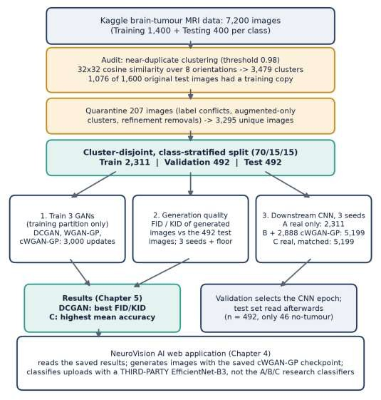
Proposed methodology and experiment pipeline
All three GANs train on the 2,311-image training partition only (hash-verified): 64×64 grayscale, batch 16, seed 42, 3,000 generator updates.
FID / KID: torch-fidelity Inception-v3 pool3, 492 generated vs 492 real test images per seed, 3 generation seeds, KID = 100 subsets of 300, plus a real-vs-real floor.
Downstream CNN (4 conv blocks, 15 epochs, 3 seeds): A real only; B real + 2,888 cWGAN-GP images; C real resampled to B’s size and class mix.
Why C matters: it controls training-set size, so only B > C would indicate a benefit specific to synthetic images.
Hardware: Apple M4 MacBook Air, PyTorch on MPS.

Slide 7
DCGAN vs WGAN-GP vs conditional WGAN-GP
 | DCGAN [3] | WGAN-GP [4, 5] | cWGAN-GP (proposed) [2, 5, 8]
Generator | z (100-d) → transposed convs, BatchNorm, Tanh | Same | Label embedding (50-d) concatenated to z
Discriminator / critic | Conv + BatchNorm, logit | Conv, no BatchNorm, scalar score | Projection critic: ψ(h(x)) + E(y)·h(x), no BatchNorm
Objective | Non-saturating BCE | Wasserstein + gradient penalty (λ = 10) | Same loss; real and fake share the label
Optimiser (Adam) | 2e-4, β (0.5, 0.999) | 1e-4, β (0.5, 0.9) | 1e-4, β (0.5, 0.9)
Updates for 3,000 steps | 3,000 discriminator | 15,000 critic (5 per step) | 15,000 critic (5 per step)
Conditioning | None | None | Requested class; no classifier guidance
Reading the comparison
Only the cWGAN-GP receives the class label; all three share the generator stack and the same data, seed and batch size.
The WGAN variants use 5x more critic updates than DCGAN's discriminator updates, so the comparison is not compute-matched; the architecture
diagram is in the report (Figure 3.4).

Slide 8
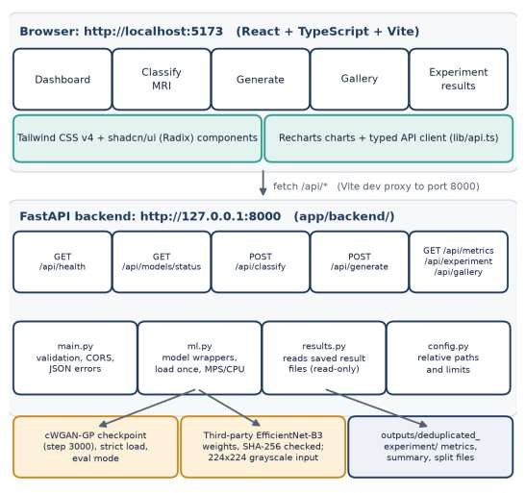
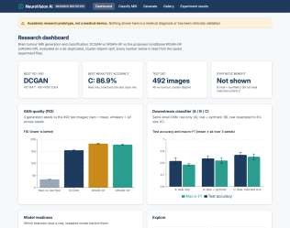
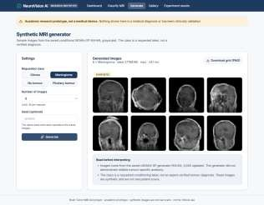
NeuroVision AI: architecture and interface
Genuine screenshots of the running application: dashboard (left) and generator (right).
Endpoints: /api/health, /models/status, /classify, /generate, /metrics, /experiment, /gallery. Models load once with strict checkpoint loading; an unavailable model gives an honest error, never a substitute.
Critical distinction
Classify MRI uses a third-party pretrained EfficientNet-B3 [14, 15]. A/B/C did not save checkpoints. Its accuracy on our test set is unknown; no out-of-distribution check.
Tests: 16 backend pytest, 6/6 smoke checks, production build; manual browser checks; no automated browser-level suite.

Slide 9
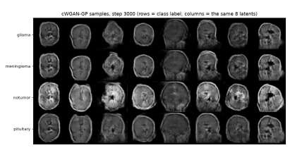
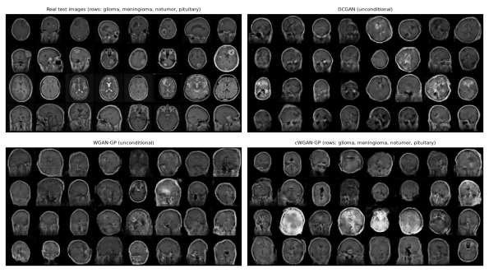
Generated samples and conditioning findings
All three GANs make head-shaped, MRI-like images with soft interiors;
none shows an identifiable tumour.
cWGAN-GP: the no-tumour row is visibly brighter; other labels look alike.
Per-class KID: only meningioma is closest to its own class; pituitary is not separated.
Conclusion on conditioning
The generator did NOT demonstrate reliable tumour-specific anatomy. Synthetic labels are requested conditions, not expert-verified diagnoses. Per-
class FID/KID rest on only 46–196 images (indicative).

Slide 10
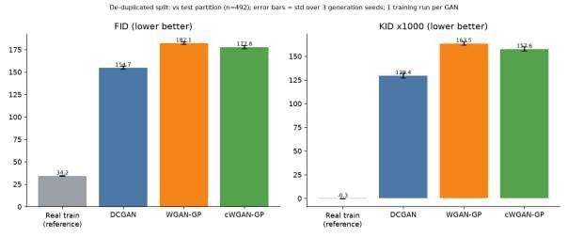
FID / KID comparison (lower is better)
Model | FID | KID × 1000
Real-vs-real floor | 34.2 ± 0.3 | −0.3 ± 0.1
DCGAN (best) | 154.7 ± 1.9 | 129.4 ± 2.4
cWGAN-GP | 177.8 ± 1.8 | 157.6 ± 2.4
WGAN-GP | 182.1 ± 1.5 | 163.5 ± 2.0
n = 492 test images; mean ± sd over 3 generation seeds.
Each GAN trained once, so training-run variance is unmeasured.
Not compute-matched: 3,000 discriminator vs 15,000 critic updates.
How to read these metrics
Inception-v3 features were learned on colour photographs; FID is biased for small samples.
They do not establish anatomical or clinical validity.

Slide 11
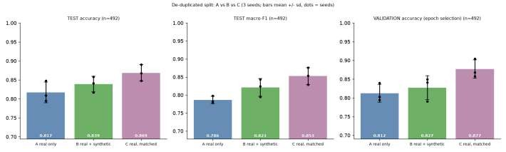
Downstream classification: conditions A, B and C
Condition | Train n | Test accuracy | Macro-F1 | Val. acc.
A: real only | 2,311 | 0.817 ± 0.027 | 0.786 ± 0.010 | 0.812
B: real + synthetic | 5,199 | 0.839 ± 0.020 | 0.821 ± 0.025 | 0.827
C: matched real only | 5,199 | 0.869 ± 0.021 | 0.853 ± 0.024 | 0.877
Test set: 492 images, 3 training seeds.
Adding cWGAN-GP images (B) beat real-only (A) in all 3 seeds (+0.022 accuracy).
But the size-matched real-only control (C) scored highest: 0.869 accuracy, 0.853 macro-F1.
Mean B − C accuracy: −0.030.
Conclusion
No benefit of synthetic augmentation beyond added training volume is demonstrated; the point estimates favour the control. A single run has ±3 accuracy points of sampling error; no significance test was run.

Slide 12
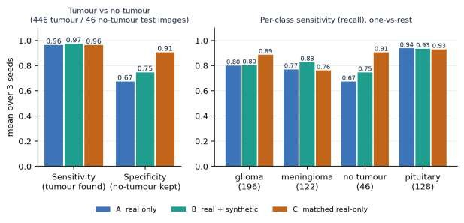
Class-wise findings, ethics and patient-safety limits
Ethics, safety and limitations
Not a medical device; never for diagnosis or treatment.
Synthetic images are not patient scans; labels are requested, not verified. Small test set (492; 46 no-tumour); patient-level independence
unproven; heuristic de-duplication.
3 seeds, one GAN run each; no significance tests.
cWGAN-GP interrupted at step 2,861 (non-finite loss); cause unconfirmed; resumed from step 2,500.
Third-party classifier may have inflated accuracy; unknown here; no OOD detection.
Dataset: matches Kaggle v2, download record unverified; CC BY 4.0,
upstream terms may differ; not redistributed.
Largest confusion in every condition: glioma predicted as meningioma (26 / 31 / 16 of 196 for A / B / C).
Tumour vs no-tumour sensitivity ≈ 0.96–0.97 for all; specificity 0.67 (A),
0.75 (B), 0.91 (C).
No-tumour rests on only 46 test images: very uncertain.

Slide 13
Conclusion and future scope
Conclusion
DCGAN gave the best generation metrics: FID 154.7, KID×1000 129.4 (cWGAN-GP 177.8 / 157.6; WGAN-GP 182.1 / 163.5).
Mean test accuracy: A 0.817, B 0.839, C 0.869. The matched-size real-only control was best, so no benefit beyond added training volume was shown.
The generator produced MRI-like images but no reliable tumour-specific anatomy.
NeuroVision AI delivers the saved results, sample generation and a
third-party classifier demo with visible limits.
Not clinically validated.
Future scope
Larger, more diverse data; patient-level splits where identifiers exist.
More GAN runs and seeds, significance tests, compute-matched baselines, longer training.
Improved conditional generation and class-consistency evaluation.
Medical-structure evaluation beyond ImageNet-feature FID/KID.
Save a research classifier checkpoint (e.g. condition C) for new-image inference.
Automated browser-level tests and out-of-distribution handling.
Clinical validation, regulatory review and oversight before any
healthcare use.

Slide 14
References and questions
Goodfellow et al., Generative Adversarial Networks, arXiv:1406.2661, 2014.
Mirza & Osindero, Conditional Generative Adversarial Nets, arXiv:1411.1784, 2014.
Radford, Metz & Chintala, DCGAN, arXiv:1511.06434, 2015.
Arjovsky, Chintala & Bottou, Wasserstein GAN, arXiv:1701.07875, 2017.
Gulrajani et al., Improved Training of Wasserstein GANs, arXiv:1704.00028, 2017.
Heusel et al., TTUR / FID, NIPS 2017; arXiv:1706.08500.
Bińkowski et al., Demystifying MMD GANs, ICLR 2018; arXiv:1801.01401.
Miyato & Koyama, cGANs with Projection Discriminator, ICLR 2018; arXiv:1802.05637.
United Nations, Transforming our world: the 2030 Agenda, 2015.
Karunya Institute of Technology and Sciences, official website.
M. Nickparvar, Brain Tumor MRI Dataset, Kaggle v2, CC BY 4.0.
Kingma & Ba, Adam, ICLR 2015; arXiv:1412.6980.
torch-fidelity 0.4.0 (software).
Tan & Le, EfficientNet, ICML 2019; arXiv:1905.11946.
Phi-007, brain-tumor-classifier (Apache-2.0) (software).
Questions?
25AI2004 AI in Healthcare | Karunya Institute of Technology and Sciences
Reminder
Academic research prototype. Dataset matches Kaggle v2; download record unverified; not redistributed. Not a medical device.

